Slide 1
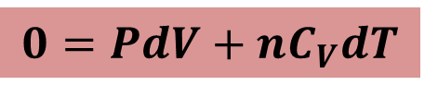

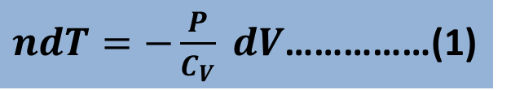
Relation Between P and V in Adiabatic Expansion
We consider n mole of gas increasing its volume by a differential amount dV at constant pressure.
From the 1st law of thermodynamics,
$$∆Q=∆W+∆E$$
$$0=PdV+nC_{V}dT$$
$ndT=−\frac{P}{C_{V}} dV$……………(1)

Slide 2


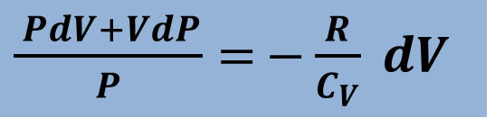
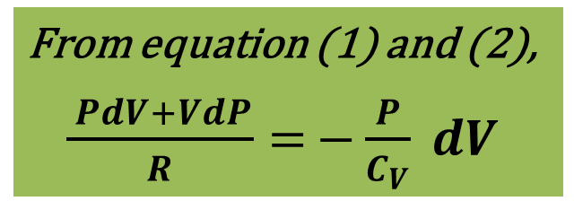
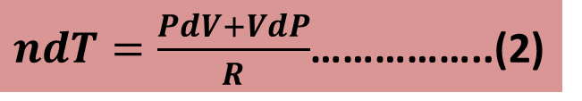
Again,
$$PV=nRT$$
$$PdV+VdP=nRdT$$
$ndT=\frac{PdV+VdP}{R}$……………..(2)
From equation (1) and (2),
$\frac{ PdV+VdP}{R}=$ $−\frac{P}{C_{V}} dV$
$\frac{ PdV+VdP}{P}=$ $−\frac{R}{C_{V}} dV$

Slide 3

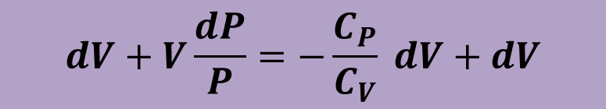

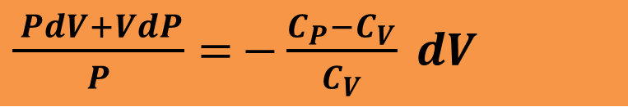

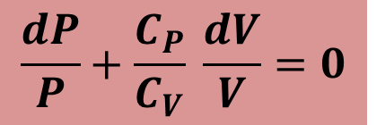
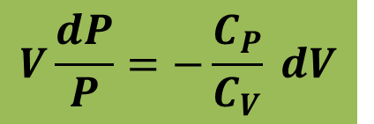
$\frac{ PdV+VdP}{P}=$ $−\frac{C_{P}−C_{V}}{C_{V}} dV$
$$dV+V\frac{dP}{P}=−\frac{C_{P}}{C_{V}} dV+dV$$
$$V\frac{dP}{P}=−\frac{C_{P}}{C_{V}} dV$$
$$\ln{PV^{γ}=Constant}$$
$$\frac{dP}{P}+\frac{C_{P}}{C_{V}} \frac{dV}{V}=0$$
$∴$ $PV^{γ}=Constant$
$$\ln{P+γ\ln{V=Constant}}$$

Slide 4
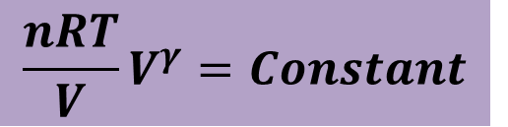


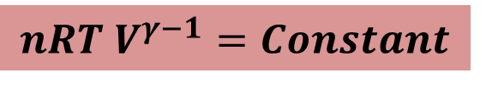
Relation Between T and V in Adiabatic Expansion
We know,
$$PV^{γ}=Constant$$
$$\frac{nRT}{V}V^{γ}=Constant$$
$$nRT{ V}^{γ−1}=Constant$$
$$T{ V}^{γ−1}=Constant$$

Slide 5
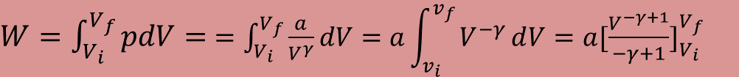


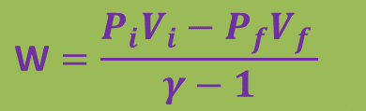
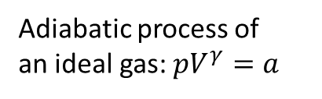
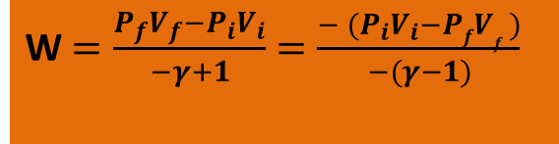
19-9 W$ork done for an ideal gas in an adiabatic process: W=\frac{P_{i}V_{i}−P_{f}V_{f}}{γ−1}$
$W=\int_{V_{i}}^{V_{f}}{pdV}=$ $=\int_{V_{i}}^{V_{f}}{\frac{a}{V^{γ}}dV}=a\int_{v_{i}}^{v_{f}}{V^{−γ}ⅆV=a{[\frac{V^{−γ+1}}{−γ+1}]}_{V_{i}}^{V_{f}}}$
Adiabatic process of
an ideal gas: $pV^{γ}=a$
$$p=\frac{a}{V^{γ}}$$
$W=\frac{a}{−γ+1}$ ${[V^{−γ+1}]}_{V_{i}}^{V_{f}}$ $=\frac{a}{−γ+1}$($V_{f}^{−γ+1}$- $V_{i}^{−γ+1}$) $=\frac{{aV}_{f}^{−γ+1}\text{− }{aV}_{i}^{−γ+1}}{−γ+1}$
$P_{i}{Vi}^{γ}=P_{f}{Vf}^{γ}$= a
$W=\frac{{aV}_{f}^{−γ+1}\text{− }{aV}_{i}^{−γ+1}}{−γ+1}$ $=\frac{{P_{f}{Vf}^{γ}V}_{f}^{−γ+1}\text{− }{P_{i}V_{i}V}_{i}^{−γ+1}}{−γ+1}$ $=\frac{{P_{f}V}_{f}^{γ−γ+1}\text{− }{P_{i}V}_{i}^{γ−γ+1}}{−γ+1}$
W $=\frac{P_{f}V_{f}−P_{i}V_{i}}{−γ+1}$ $=\frac{{− (P}_{i}V_{i}−PfV_{f })}{−(γ−1)}$
$$\text{W}=\frac{P_{i}V_{i}−P_{f}V_{f }}{γ−1}$$

Slide 6






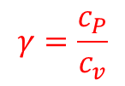


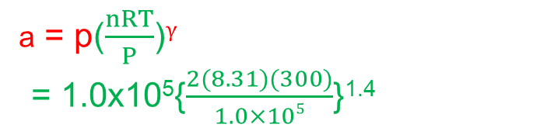
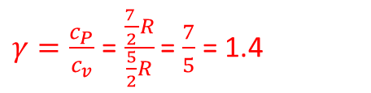
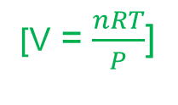
54. We know that for an adiabatic process pV^{γ} = a constant. Evaluate “a constant” for an adiabatic process involving exactly 2.0 mol of an ideal gas passing through the state having exactly p = 1.0 atm and T = 300 K. Assume a diatomic gas whose molecules rotate but do not oscillate.
Solution:
p$V^{γ}$ = constant
Here, n = 2 mol
T = 300 K
a = p$V^{γ}$
P = 1.0 atm = 1.0x10⁵ Pa
[Ideal gas law, pV = nRT]
a = p($\frac{nRT}{P}$)$γ$
= 1.0x10⁵{$\frac{2(8.31)(300)}{1.0×105}$}^{1.4}
p$V^{γ}$ = constant
$$γ=\frac{c_{P}}{c_{v}}$$
[V = $\frac{nRT}{P}$]
Diatomic gas whose molecules rotate
but do not oscillate, f = 3+2 = 5
= 1.0x10⁵{0.04986}^{1.4}
C_{V} = ($\frac{f}{2})R=$ ($\frac{5}{2})R$
a =1.5x10³ Nm^{2.2}
C_{p} – C_{V} = R
C_{p} = C_{V} + R = ($\frac{5}{2})R$ + R = ($\frac{7}{2})R$
Unit of a = p$V^{γ}$ = ($\frac{N}{m^{2}}$)($m^{3}$)$γ$
$=Nm^{3γ−2}$ = $Nm^{3\left(1.4\right)−2 }$
$γ=\frac{c_{P}}{c_{v}}$ =$\frac{\frac{7 }{2}R}{\frac{5}{2}R}$ = $\frac{7}{5}$ = 1.4
a = $Nm^{2.2}$

Slide 7
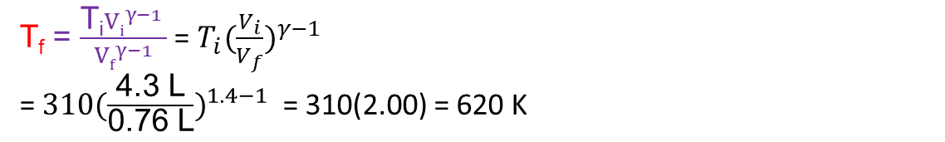





55. A certain gas occupies a volume of 4.3 L at a pressure of 1.2 atm and a temperature of 310 K. It is compressed adiabatically to a volume of 0.76 L. Determine (a) the final pressure and (b) the final temperature, assuming the gas to be an ideal gas for which γ = 1.4.
Solution:
(b) T$V^{γ−1}$ = constant
Here, V_{i} = 4.3 L
T_{i}${Vi}^{γ−1}$ = T_{f}${Vf}^{γ−1}$
p_{i} = 1.2 atm = 1.2x10⁵ Pa
T_{i} = 310 K
T_{f} = $\frac{\text{T}\text{i}{Vi}^{γ−1} }{{Vf}^{γ−1}}$ = ${T_{i}(\frac{V_{i}}{V_{f}})}^{γ−1}$
= ${\text{310}(\frac{\text{4.3 }\text{L}}{\text{0.76 }\text{L}})}^{1.4−1}$ = 310(2.00) = 620 K
V_{f} = 0.76 L
$γ$ = 1.4
(a) p$V^{γ}$ = constant
p_{i}${Vi}^{γ}$ = p_{f}${Vf}^{γ}$
$\text{p}\text{f}=\frac{\text{p}\text{i}{Vi}^{γ}}{{Vf}^{γ}}$ =p_{i}( $\frac{{Vi}^{γ}}{{Vf}^{γ}}$) = ${p_{i}(\frac{V_{i}}{V_{f}})}^{γ}$ = ${\text{1.2}\text{x}{10}^{5}(\frac{\text{4.3 }\text{L}}{\text{0.76 }\text{L}})}^{1.4}$ $=\text{1.2}\text{x}{10}^{5}\text{(11.3166)}$= $\text{1.36}\text{x}{10}^{6} \text{Pa}$

